Slide 1
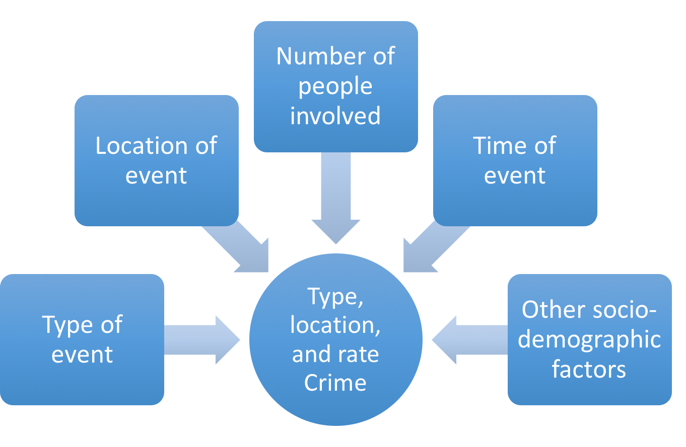

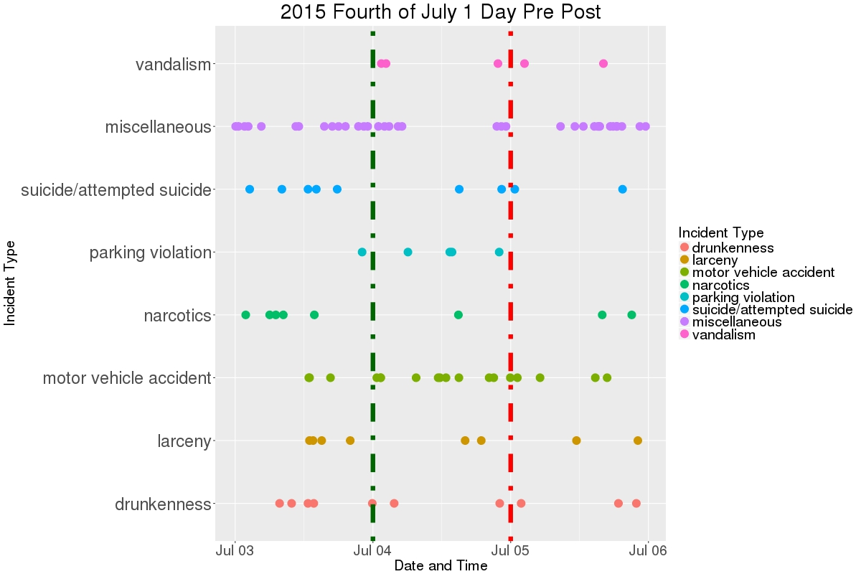
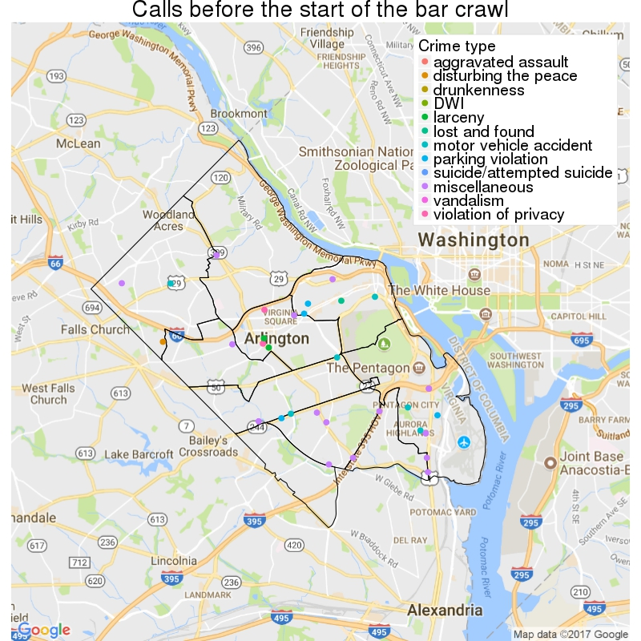
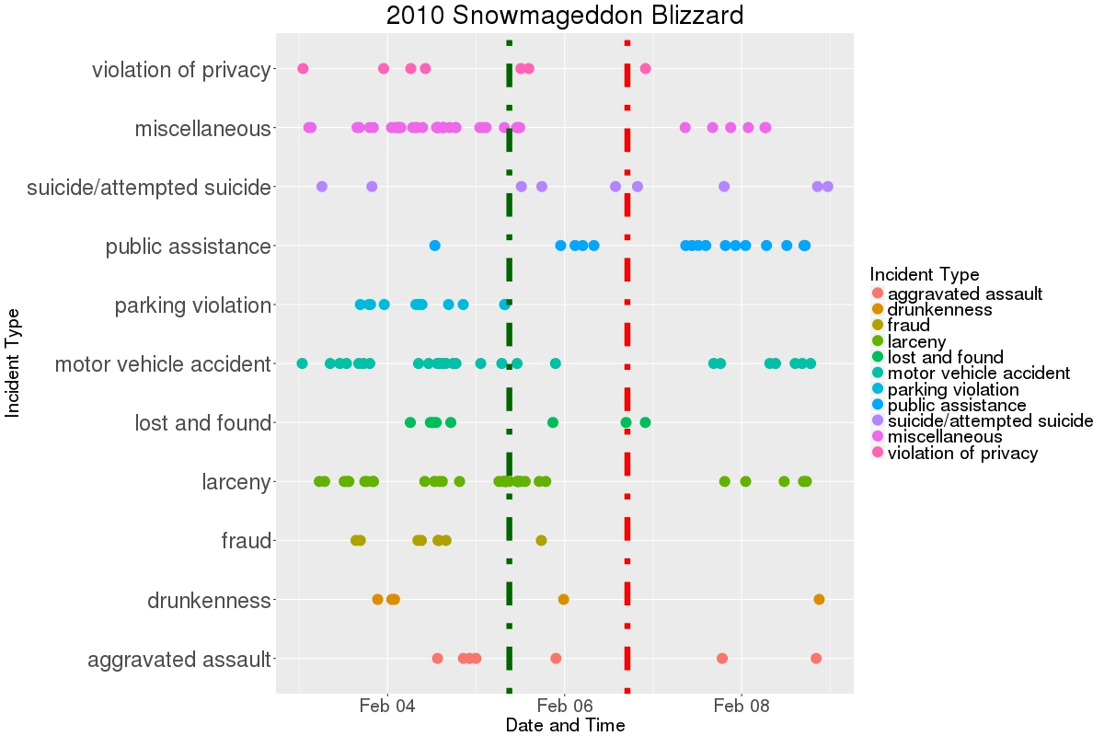
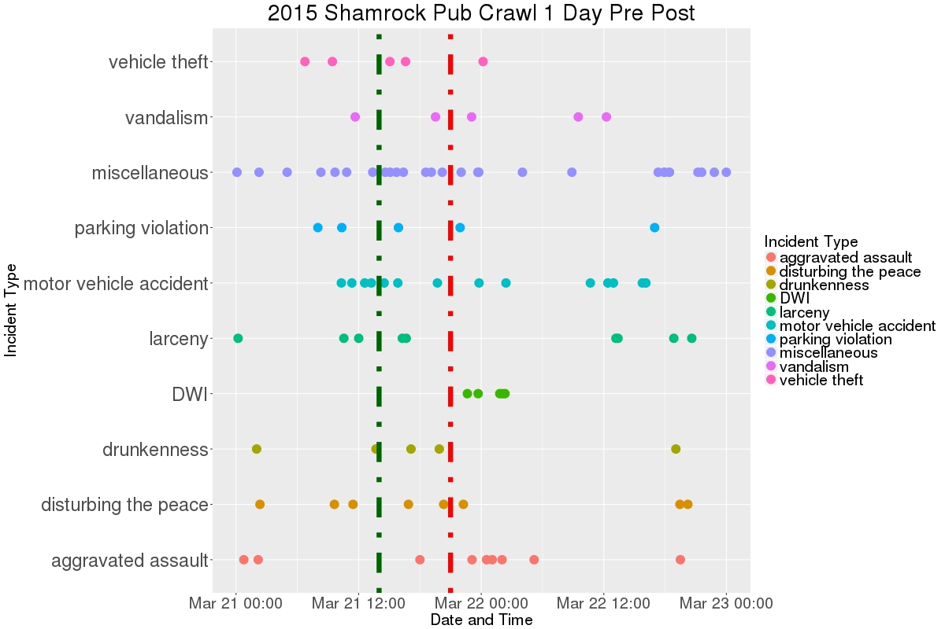
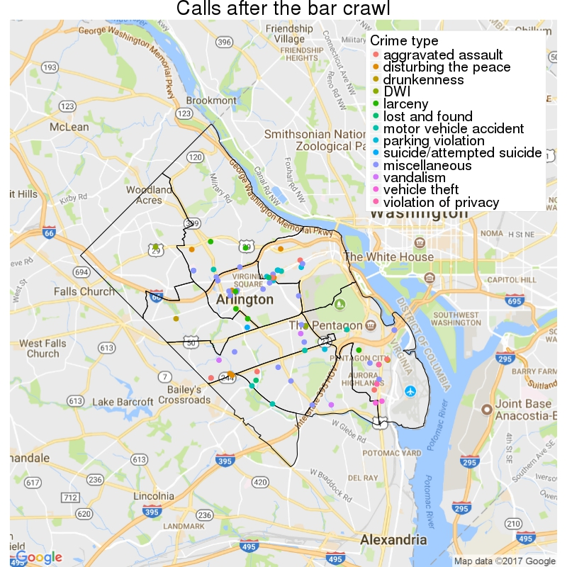
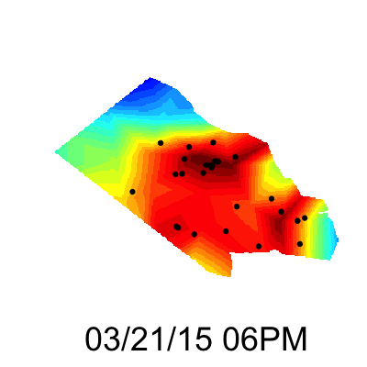
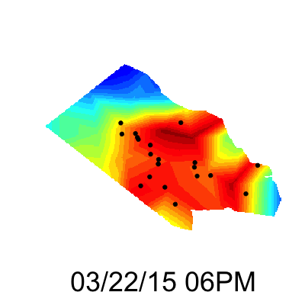
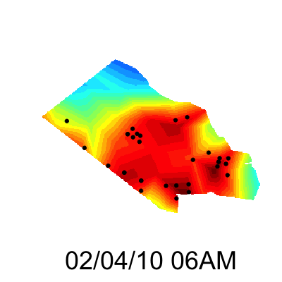
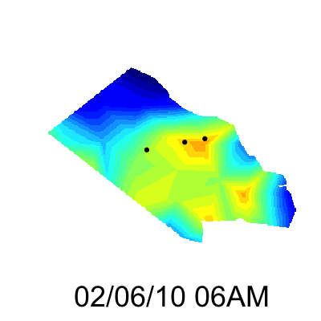

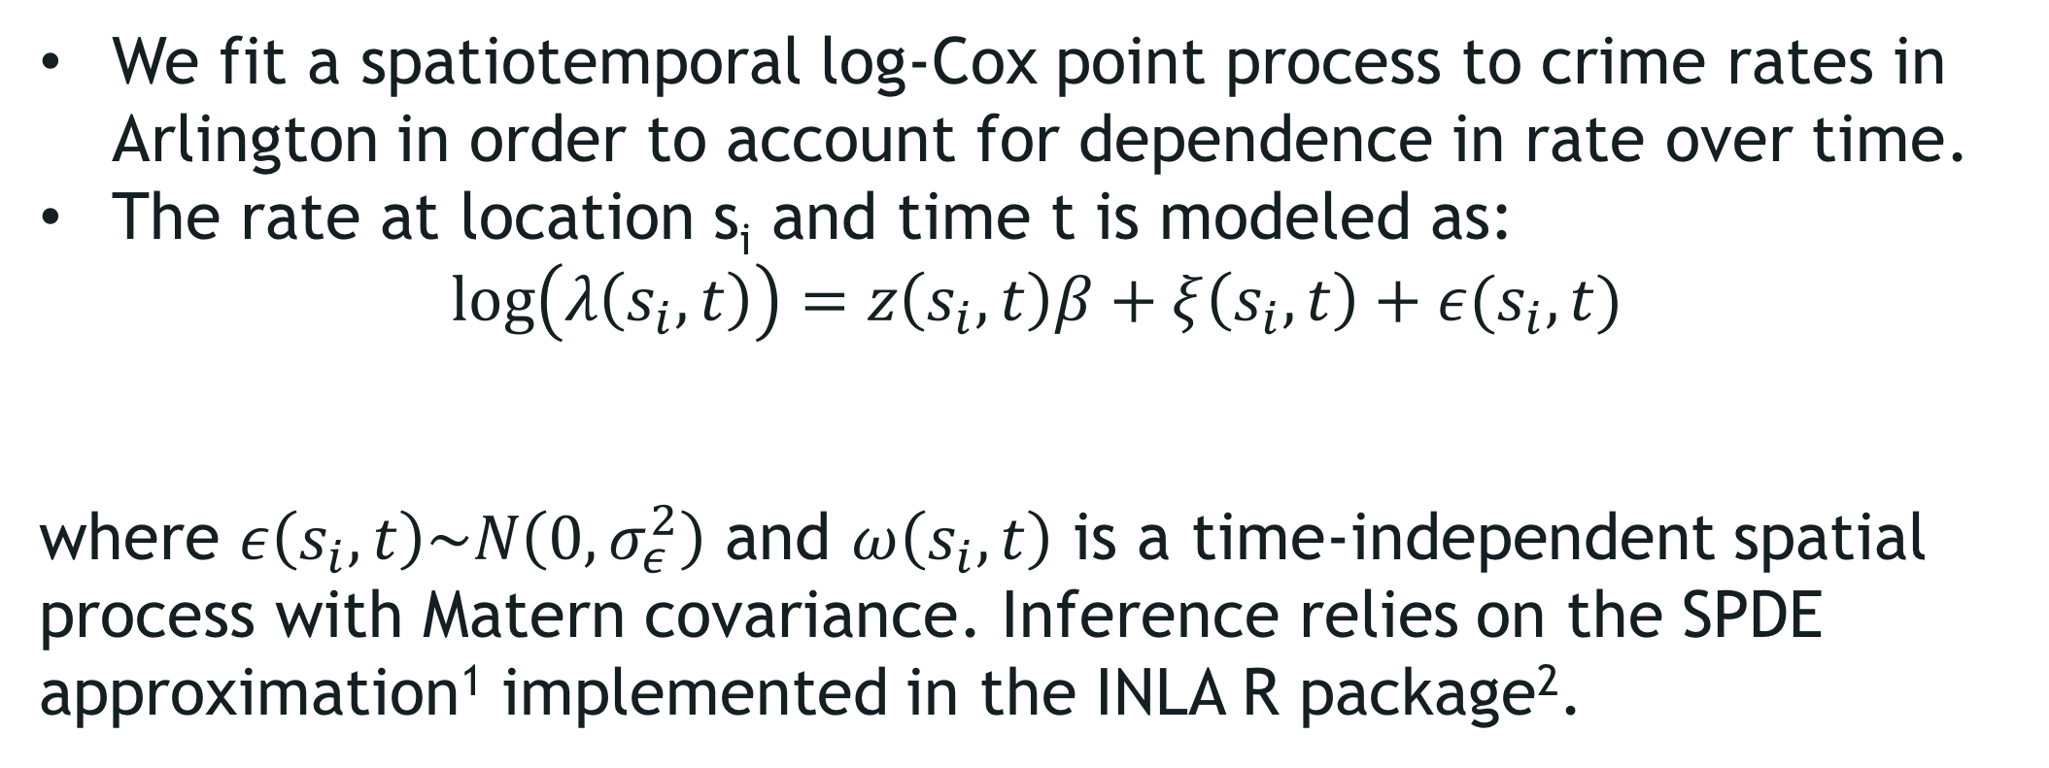
How do events affect crime?
Hannah Brinkley (VT), Craig Morton (VT), Claire Kelling (PSU), Sayali Phadke (PSU)
with Josh Goldstein and Gizem Korkmaz (SDAL)
Sponsor: Captain Bruce Benson and Niki Levy, Arlington County Police Department
Research Question
Data
What to expect from specific events so that the Arlington County Police Department (ACPD) can be better prepared?
Seven relational data tables about 911 calls and crime incidents provided by the ACPD
Available for 2005-2015
Reports a total of 1,064,099 Calls for Service and 261,944 incidents
For this analysis we use:
Type of incident recorded
Exact date and time of the 911 call
Location of crime
We gathered event data from various sources including Yelp.com for social events.
Types of events of interest:
Political events, e.g., elections and inaugurations
Weather events, e.g., snowstorms, hurricanes, hottest day of the year, tropical storms
Sports events, e.g., Super Bowl, playoff games for the Washington sports teams, marathons
Holidays, e.g., Halloween, Memorial Day
Social events: All events listed on Yelp.com for Arlington. Popular events include wine testing, pub crawls, national cheesecake day
Exploratory Data Analysis
We expect that a drinking-based social event will lead to an increase in alcohol-related and public disturbance-related crimes. Data supports this.
Before
Start Date
End Date
Start Date
End Date
We expect that certain holidays will result in more people celebrating, leading to an increase in alcohol-related crimes. Data suggests increase in motor vehicle related incidents.
After
We expect that extreme weather events would result in people spending extended periods of time in their homes, leading to an increase in domestic abuse-related crimes.
Start Date
End Date
The Model & Findings
We fit a spatiotemporal log-Cox point process to crime rates in Arlington in order to account for dependence in rate over time.
The rate at location s_{i} and time t is modeled as:
$$\log\left(λ\left(s_{i},t\right)\right)=z\left(s_{i},t\right)β+ξ\left(s_{i},t\right)+ε(s_{i},t)$$
where $ε\left(s_{i},t\right)\sim N\left(0,σ_{ε}^{2}\right)$ and $ω\left(s_{i},t\right)$ is a time-independent spatial process with Matern covariance. Inference relies on the SPDE approximation¹ implemented in the INLA R package².
Before After
Snowmageddon blizzard on 02/05-02/06, 2015: Intensity of estimated crime decreased significantly
$$ξ\left(s_{i},t\right)=aξ\left(s_{i},t−1\right)+ω\left(s_{i},t\right)$$
Before After
The maps on the right illustrate the effects of Snowmageddon and one of the popular pub crawls in Arlington.
We do not observe a significant change in crime rate during the Super Bowl, and we observe that the crime rate is generally higher at night.
Pub crawl in Arlington on 03/21/2015: Intensity of estimated crime increased significantly
After controlling for this time of day effect, we estimate an increase in crime rate during the night of the pub crawl (March 21st, 2-9pm)
Statistically significant reduction in crime rate when comparing the periods before the blizzard (Feb 1st-5th) to the days immediately following it (Feb 6th-10th)
Next Steps
Visualize and model effect for more types of events.
Consult with ACPD to understand which other events would be of interest to them.
Investigate various crime types further, to understand differential effect.
References
[1] Lindgren, Finn, Håvard Rue, and Johan Lindström. "An explicit link between Gaussian fields and Gaussian Markov random fields: the stochastic partial differential equation approach." Journal of the Royal Statistical Society: Series B (Statistical Methodology) 73.4 (2011): 423-498.
[2] www.r-inla.org

